Slide 1

PNEUMONIA PREDICTION AND DECISION SUPPORT SYSTEM
DEPARTMENT OF ARTIFICIAL INTELLIGENCE AND DATA SCIENCE
Batch No: 10
Supervisor Name:
Mrs.Hemalatha
Presented By:
Karthikeyan.S (412621243027)
Mohan.A (412621243033)
Narmadha.V (412621243034)
Sudharshan.M (412621243050)

Slide 2
ABSTRACT
Pneumonia is a leading cause of mortality worldwide, requiring early and accurate detection. Traditional diagnostic approaches, such as manual X-ray analysis and blood test evaluation, are prone to delays and human errors. This project introduces an AI-driven Pneumonia Prediction and Decision Support System (PPDSS), integrating Deep Learning (DL) for X-ray analysis and Machine Learning (ML) for blood test evaluation. By leveraging CNN-based image classification, biomarker analysis, and AI fusion techniques, this system enhances diagnostic accuracy, speed, and accessibility.

Slide 3
CHALLENGES
1. Overlapping Symptoms: Pneumonia shares symptoms with other respiratory diseases.
2. Subjectivity in X-ray Interpretation: Different radiologists may provide varying opinions.
3. Delay in Diagnosis: Manual analysis takes time, delaying treatment.
4. Data Availability Issues: High-quality labeled datasets are scarce.
5. AI Model Explainability: Clinicians require interpretable AI results.
6. Healthcare System Integration: Seamless EMR incorporation is needed.

Slide 4
EXISTING RESEARCH
1. CheXNet: Radiologist-Level Pneumonia Detection (Stanford University)
Uses a 121-layer CNN to classify pneumonia from X-ray images.
Limitation: Requires large labeled datasets.
2. Biomarkers in Pneumonia Detection (Harvard Medical School)
Uses Random Forest for analyzing CRP and WBC count.
Limitation: Variability in blood test results.
3. Multimodal AI for Disease Prediction (MIT)
Combines imaging and clinical data using ensemble learning.
Limitation: High computational complexity.

Slide 5
LITERATURE SURVEY (Table)
Method | Overview | Strengths | Limitations
CheXNet (Stanford) | DenseNet-121 CNN on X-rays | Radiologist-level accuracy Multiple disease detection Efficient workflow | Needs large labeled data Label bias risk Domain shift performance drop
Biomarker-Based (RF) | CRP, WBC used in Random Forest | No imaging needed Low-cost & interpretable Small dataset usable | Biomarker variability Low specificity Possible misclassification
Multimodal AI (MIT) | Fusion of X-rays, EHR, lab tests | Holistic, accurate & personalized Outperforms single models | High compute cost Integration issues Unstructured data challenges

Slide 6
Method | Overview | Strengths | Limitations
Vision Transformer (ViT-Based Models) | Uses self-attention transformer architecture on medical images | High interpretability, effective at capturing global context, flexible with various input modalities | Requires large datasets for training, high compute cost, may overfit small datasets
NLP-Based Clinical BERT | Pretrained BERT model fine-tuned on clinical notes and EHRs | Strong performance on unstructured text, enables context-aware understanding, improves clinical decision support | Sensitive to data quality and bias, struggles with rare or ambiguous terms, requires careful fine-tuning
Federated Learning for Healthcare | Decentralized model training across multiple hospitals without sharing raw data | Preserves data privacy, enables collaborative model improvement. | Complex synchronization, variable data quality across sites, slower convergence

Slide 7
PROPOSED SYSTEM
1. Deep Learning for X-ray Analysis
  Models: ResNet-50, VGG-16, DenseNet-121
  Detects pneumonia features in chest X-rays
  Uses Grad-CAM for visual interpretability
2. Machine Learning for Blood Test Evaluation
  Inputs: CRP, WBC, Neutrophil-Lymphocyte Ratio
  Algorithms: Random Forest, XGBoost, SVM
  Classifies bacterial vs. viral pneumonia
3. Multimodal Fusion Layer
  Combines CNN and lab-test features
  Final output: Normal, Bacterial Pneumonia, Viral Pneumonia

Slide 8
4. Explainable AI Integration
  Grad-CAM: Highlights infected lung regions
  SHAP: Ranks biomarker importance for clinicians
5. Deployment Strategy
  Cloud API: Hospital EMR integration
  Edge AI: Portable diagnosis in rural clinics
  Telemedicine: Remote patient support

Slide 9
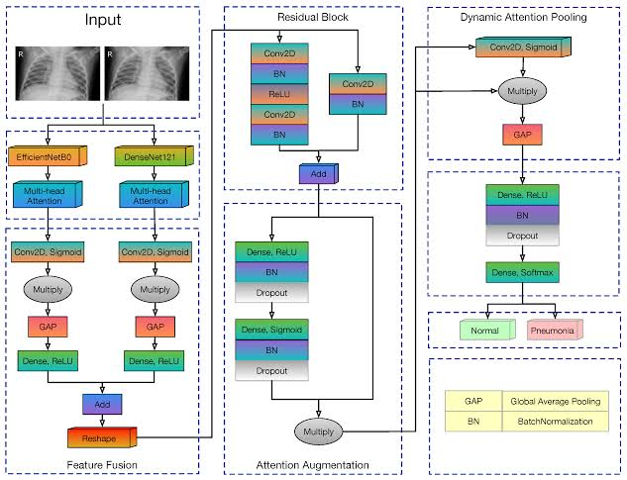
System Architecture

Slide 10
To address these challenges, the PPDSS incorporates:
Deep Learning for X-ray Analysis – CNN models (ResNet, VGG, DenseNet) for classification.
Machine Learning for Blood Test Evaluation – Random Forest, XGBoost, SVM for biomarker analysis.
Explainability via Grad-CAM & SHAP – Ensuring transparent AI decisions.
AI Fusion Model – Combining X-ray and blood test data for higher accuracy.
Cloud and Edge AI Deployment – Enabling scalability for different healthcare settings.

Slide 11
PROPOSED MODULES
Deep Learning in X-ray Analysis
CNNs like AlexNet, VGG16, DenseNet, ResNet are widely used in medical imaging.
CheXNet (Stanford): 121-layer DenseNet, radiologist-level performance on pneumonia.
VGG16: Smaller model, good for transfer learning with smaller datasets.
DenseNet201: Best accuracy (91.49%) in your project due to feature reuse.
XceptionNet: Separable convolutions reduce complexity while maintaining accuracy.

Slide 12
Biomarker-Based Diagnosis
Studies show CRP, WBC, Neutrophils, and Lymphocytes are reliable pneumonia indicators.
Harvard research used Random Forest on blood data to support pneumonia detection.
Limitation: Biomarkers vary based on individual health, making diagnosis complex if used alone.

Slide 13
Multimodal AI Models
MIT work: Combined image and clinical data using ensemble models.
Fusion Layers:
Purpose: Learn from both visual (images) and physiological (clinical) inputs.
Benefit: Improved generalization and cross-modality learning for better decision-making.
Challenges:
High Computational Demand: Requires powerful hardware for training complex models.
Data Imbalance: Medical datasets may have uneven distribution of conditions, affecting model performance.
Need for Large Labeled Datasets: Difficulty in acquiring sufficient high-quality labeled medical data.

Slide 14
Explainable AI (XAI) in Healthcare
Grad-CAM for X-ray Interpretability – Highlights affected lung regions.
SHAP for Blood Test Feature Importance – Identifies key biomarkers.
Improving Trust in AI-Based Diagnosis – Ensures transparent AI decisions.
Addressing the 'Black Box' Issue – AI models must be interpretable for clinicians.

Slide 15
ALGORITHMS USED- Overview
Our Pneumonia Prediction and Decision Support System (PPDSS) integrates Deep Learning for image data and Machine Learning for clinical data. A fusion-based approach improves diagnostic accuracy and reliability.
Deep Learning (CNN) for Chest X-rays
Machine Learning (ML) for Blood Test Analysis
Fusion Layer for Multimodal Integration
Optimized using Adam with Categorical Crossentropy

Slide 16
CNN Models for Chest X-ray Analysis
Chest X-rays are analyzed using three pre-trained Convolutional Neural Networks (CNNs) fine-tuned on pneumonia datasets.
VGG16
Simple architecture; effective for transfer learning.
Used as a baseline for comparison.
DenseNet201
Achieved best performance (91.49% accuracy).
Leverages dense connections to reuse features and reduce gradient loss.
XceptionNet
Uses separable convolutions to reduce parameters and improve speed.

Slide 17
ML Models for Blood Test Analysis
Blood parameters such as WBC, CRP, Neutrophils, and Lymphocytes are used for pneumonia classification.
Random Forest
Handles non-linear feature interactions well.
XGBoost
Gradient-boosting technique used for performance comparison.
Support Vector Machine (SVM)
Effective for high-dimensional clinical data.

Slide 18
Feature Fusion and Final Classification
A fusion layer combines deep image features and clinical indicators to make final predictions.
Fusion Layer
Combines CNN and ML feature vectors using weighted averaging.
Dense Layers + Softmax
Final classifier predicts 3 classes:
Normal
Bacterial Pneumonia
Viral Pneumonia

Slide 19
Optimization and Evaluation
The model was optimized and evaluated using standard metrics and early stopping to prevent overfitting.
Optimizer: Adam – adaptive learning rate and fast convergence
Loss Function: Categorical Cross-Entropy
Batch Size: 32 Epochs: 5
Evaluation Metrics:
Accuracy
Precision & Recall
AUC-ROC Curve

Slide 20
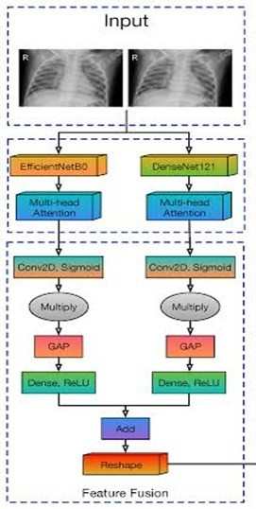
Work Flow
1. Input: Two chest X-ray images (left & right branches)
2. Feature Extraction:
Left Branch: EfficientNetB0
Right Branch: DenseNet121
3. Attention Mechanism:
Multi-Head Attention
Conv2D + Sigmoid.
Multiply operation
4. Feature Reduction:
GAP (Global Average Pooling)
Dense (ReLU) layers learn deep representations.
5. Reshape:
Application:
Robust classification of chest conditions (e.g., Pneumonia, COVID-19).
Combines strengths of two CNNs + attention
for improved accuracy.

Slide 21
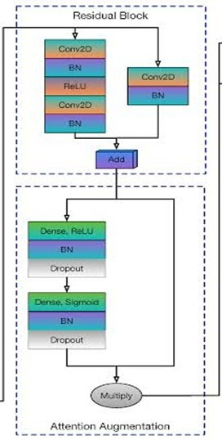
Attention Augmentation with Residual Block
Residual Block
Conv2D → BN → ReLU → Conv2D → BN
Shortcut path: Conv2D + BN
Add both paths → helps deeper learning
Attention Augmentation
Dense + ReLU + BN + Dropout
Dense + Sigmoid + BN + Dropout
Learns important features
Feature Refinement
Final Multiply enhances key features based on learned attention
Boosts model performance by focusing on important parts of the feature map

Slide 22
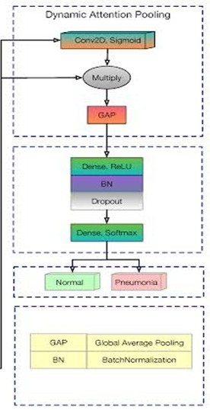
Dynamic Attention Pooling
Dynamic Attention Pooling
Conv2D + Sigmoid → Creates attention map
Multiply → Highlights important features
GAP (Global Average Pooling) → Reduces feature size
Classification Layer
Dense + ReLU + BN + Dropout → Learns deep patterns
Dense + Softmax → Final prediction
Output
Predicts: Normal / Pneumonia
GAP: Global Average Pooling
BN: Batch Normalization

Slide 23
Result Discussion
Comparative Analysis of CNN Models
Model | Test Accuracy (%) | Strengths | Limitations
VGG16 | 87.40% | Simple, effective for small datasets | Higher parameters, slower inference
XceptionNet | 83.37% | Fast, lightweight with separable convs | Slightly lower accuracy
DenseNet201 | 91.49% | Best performance, efficient feature reuse | More complex, higher memory usage

Slide 24
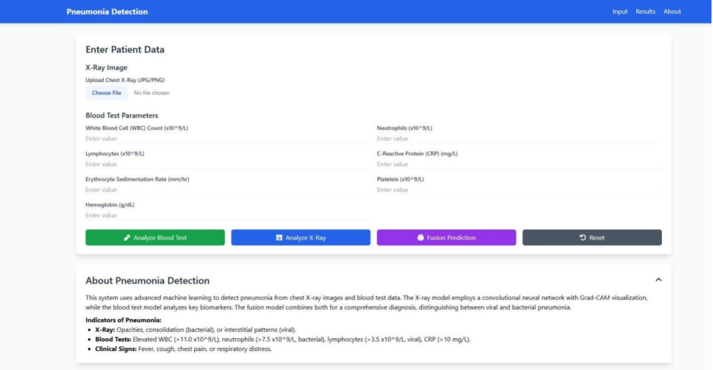
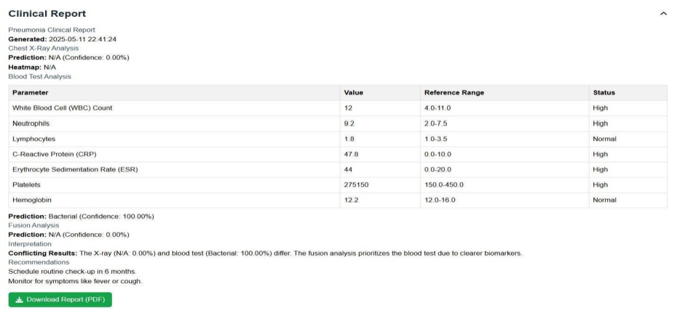
FIGURE 1 :WEB APPLICATION
INTERFACE
FIGURE 2: BLOOD TEST
REPORT

Slide 25
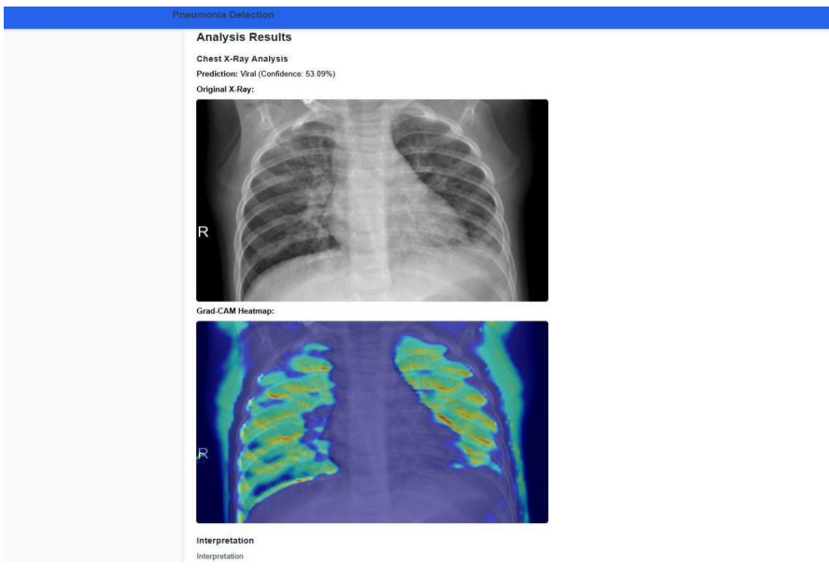
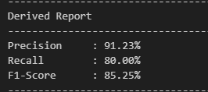
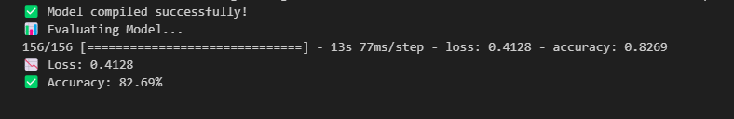
FIGURE 3: X-RAY PREDICTION
Test Accuracy of Model
Test Acurracy and Loss

Slide 26
FUTURE WORK
Real-World Clinical Validation – Conduct trials with hospitals.
Dataset Expansion – Include diverse patient populations.
Model Optimization – Improve accuracy while reducing computational costs.
Regulatory Compliance – Ensure HIPAA/GDPR compliance for patient data security.

Slide 27
CONCLUSION
The Pneumonia Prediction and Decision Support System (PPDSS) integrates AI-driven methodologies to enhance pneumonia diagnosis by combining X-ray imaging and blood test analysis. With a focus on accuracy, interpretability, and scalability, PDSS is a promising solution for hospitals, telemedicine, and rural healthcare.
Future work includes real-world clinical trials, dataset expansion, and regulatory approval.

Slide 28
REFERENCES
[1] Alaa M. A. Barhoom and Prof. Dr. Samy S. Abu Naser, (2022), “Diagnosis of Pneumonia Using Deep Learning International Journal of Academic Engineering Research”, Vol. 6 (Issue 2), pp. 48-68.
[2] Albawi, S.; Mohammed, T.A.; Al-Zawi, S, (2017), “Understanding of a convolutional neural network”, 2017 International Conference on Engineering and Technology (ICET), Antalya, Turkey, 21–23 August 2017, pp. 1–6.
[3] Ali Sharif Razavian, Hossein Azizpour, Josephine Sullivan, and Stefan Carlsson, (2014), “CNN features off-the-shelf: an astounding baseline for recognition”, in proceedings of IEEE Conference on Computer Vision and Pattern Recognition workshops, pp. 806 - 813.
[4] M. Anthopoulos, S. Christodoulidis, L. Ebner, A. Christe, and S.Mougiakakou, (2016), "Lung Pattern Classification for Interstitial Lung Diseases Using a Deep Convolutional Neural Network," in IEEE Transactions on Medical Imaging, vol. 35, (Issue no. 5), pp. 1207- 1216.

Slide 29
[5] D. Demner-Fushman, M.D. Kohli, M.B. Rosenman, S.E. Shooshan, L. Rodriguez, S. Antani,G.R. Thoma, and C.J. McDonald, (2016), “Preparing a collection of radiology examinations for distribution and retrieval”, J Am Med Inform Assoc, Vol 23(2), pp.304 – 10
[6] Dev Kumar Das, Madhumala Ghosh, Mallika Pal, Asok K Maiti, Chandan Chakraborty, (2013), “Machine learning approach for automated screening of malaria parasite using light microscopic images”, Micron 45, pp. 97-106.
[7] X. Glorot and Y. Bengio, (2010), "Understanding the difficulty of training deep feedforward neural networks", Proceedings of the thirteenth International Conference on Artificial Intelligence and Statistics, pp. 249-256. 57
[8] Kai-Lung Hua, Che-Hao Hsu, Shintami Chusnul Hidayati, WenHuang Cheng, and Yu-Jen Chen, (2015), “Computer-aided classification of lung nodules on computed tomography images via deep learning technique”, OncoTargets and therapy, vol 8, pp. 506 - 513

Slide 30
[11] Mahdieh Poostchi, Kamolrat Silamut, Richard Maude, Stefan Jaeger, George Thoma, (2018), “Image analysis and machine learning for detecting malaria”, Translational Research, Vol 194, pp. 36-55.
[12] S. Militante, (2019),"Fruit Grading of Garcinia Binucao (Batuan) using Image Processing.", International Journal of Recent Technology and Engineering (IJRTE), vol 8.2, pp. 1829-1832.
[13] S. V. Militante, B. D. Gerardo, and N. V. Dionisio, (2019), "Plant Leaf Detection and Disease Recognition using Deep Learning,", IEEE Eurasia Conference on IoT, Communication and Engineering (ECICE), Yunlin, Taiwan, pp. 579-582. [14] S. V. Militante, and B. G. Sibbaluca,(2020), “Pneumonia Detection Using Convolutional Neural Networks”, International Journal of Scientific & Technology Research, Volume 9( Issue 04), pp. 1332-1337.

Slide 31
Thank You

